Slide 1
TABLEAU PROJECT on NETFLIX Data Set
Prepared By :- Aniket Rajendra shoste
( Board infinity )

Slide 2
OVERVIEW
THIS PROJECT IS BASED ON NETFLIX DATA ,GOT SOME VALUABLE INSIGHTS AND BELOW IS SOME INFORMATION ABOUT DATA.
THIS DATASET CONSIST OF 12 COLUMNS & 8807 ROWS.
FROM THIS DATASET ,THE FIELDS WHICH ARE USED AS FOLLOWS :-
Title , Director , Cast , Country , Date_added , Release_year , Rating , Duration , Listed_in/ Genre, Description , Area , Years , Revenue , Subscribers.

Slide 3
QUESTIONS BASED ON DATASET
Movie & TV Show Distribution .
World Wide Movies & TV Shows.
Top 10 Countries with most Netflix Content movies and TV shows Split.
Top 10 Directors with most Movies & TV shows on Netflix.
Top 10 Actors Movies and Tv shows.
Movies & TV shows added over Time.
Month By Month view of Content Added.
Distribution of Rating by Movies & Tv shows.
Targeting Audiences as per Country.
Total no of Movies & TV shows made in different Genre.
Number of Movies and TV Shows per year .
Region wise Revenue & Subscribers for past 3 years.
Average Duration of Movies & TV shows .
Rank status of top Ratings over the Years.

Slide 4
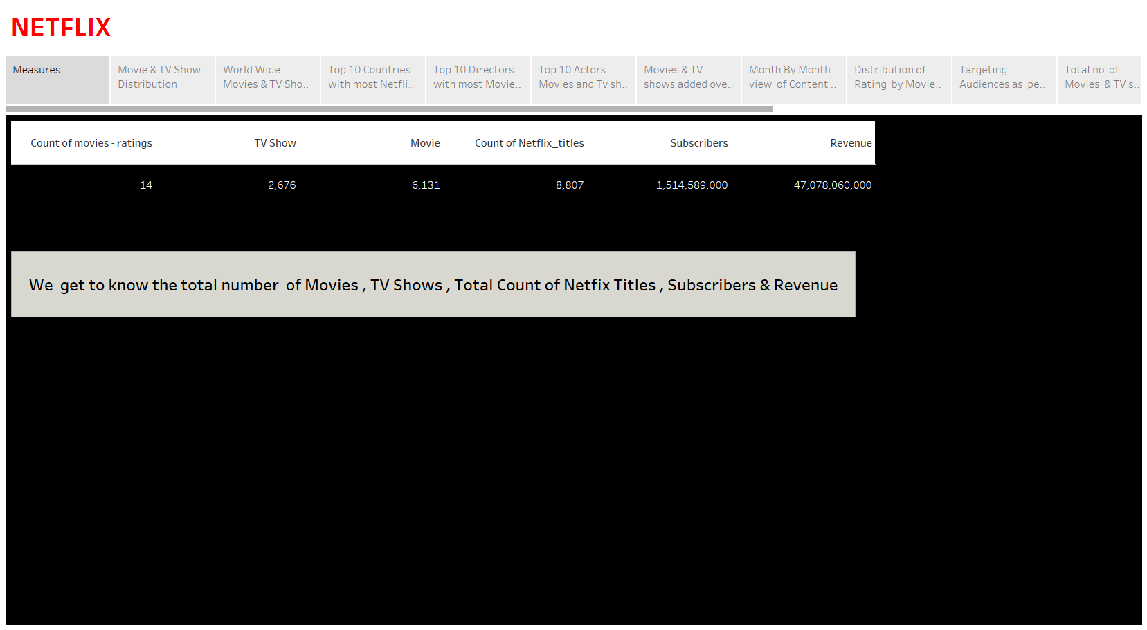

Slide 5
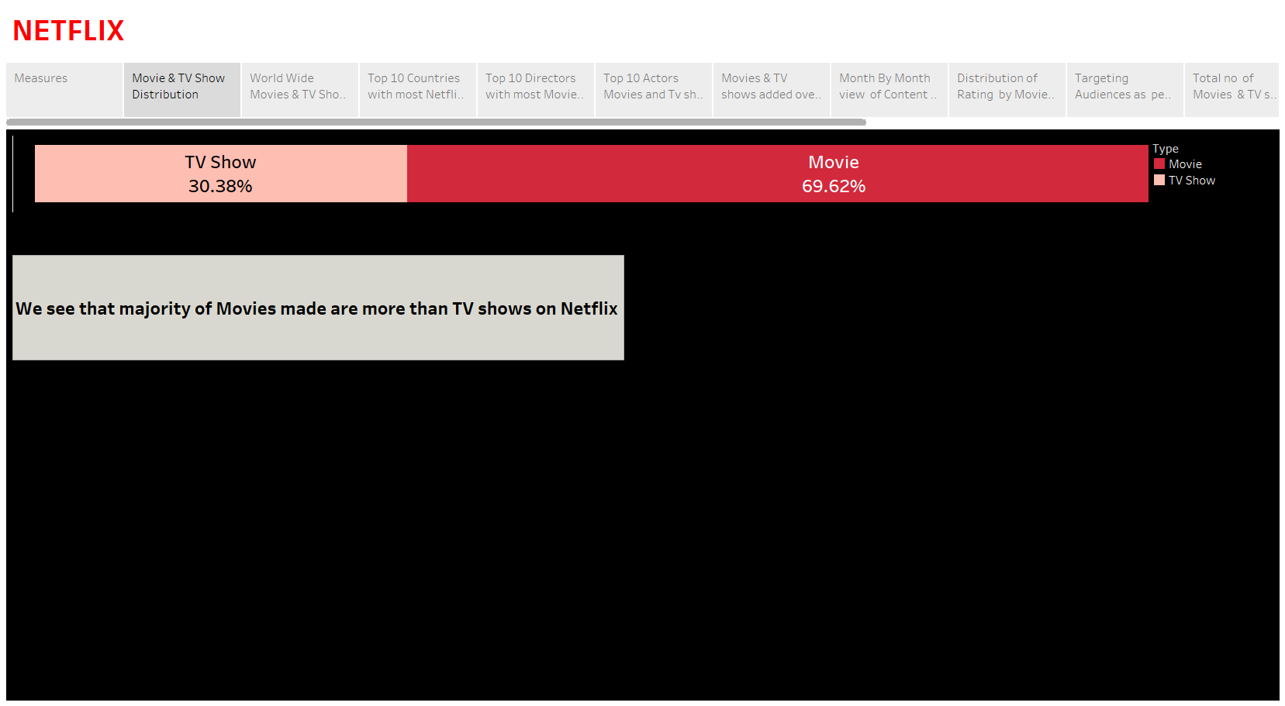

Slide 6
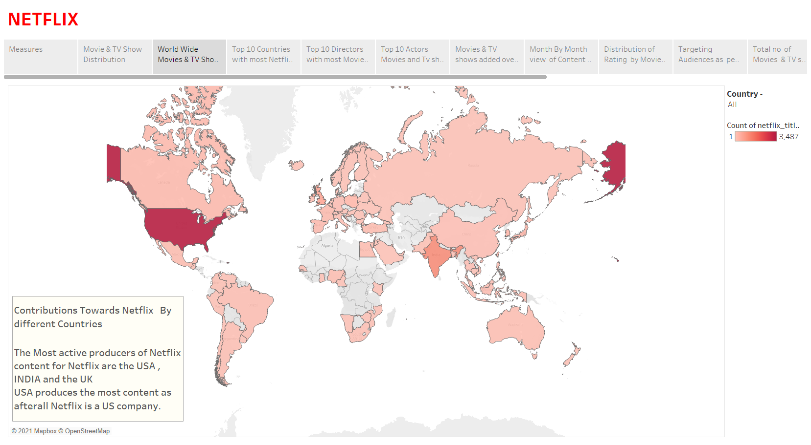

Slide 7
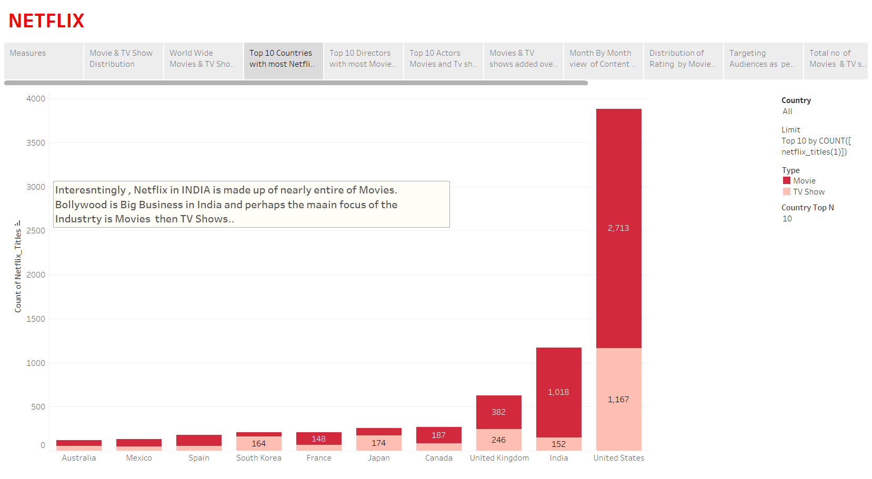

Slide 8
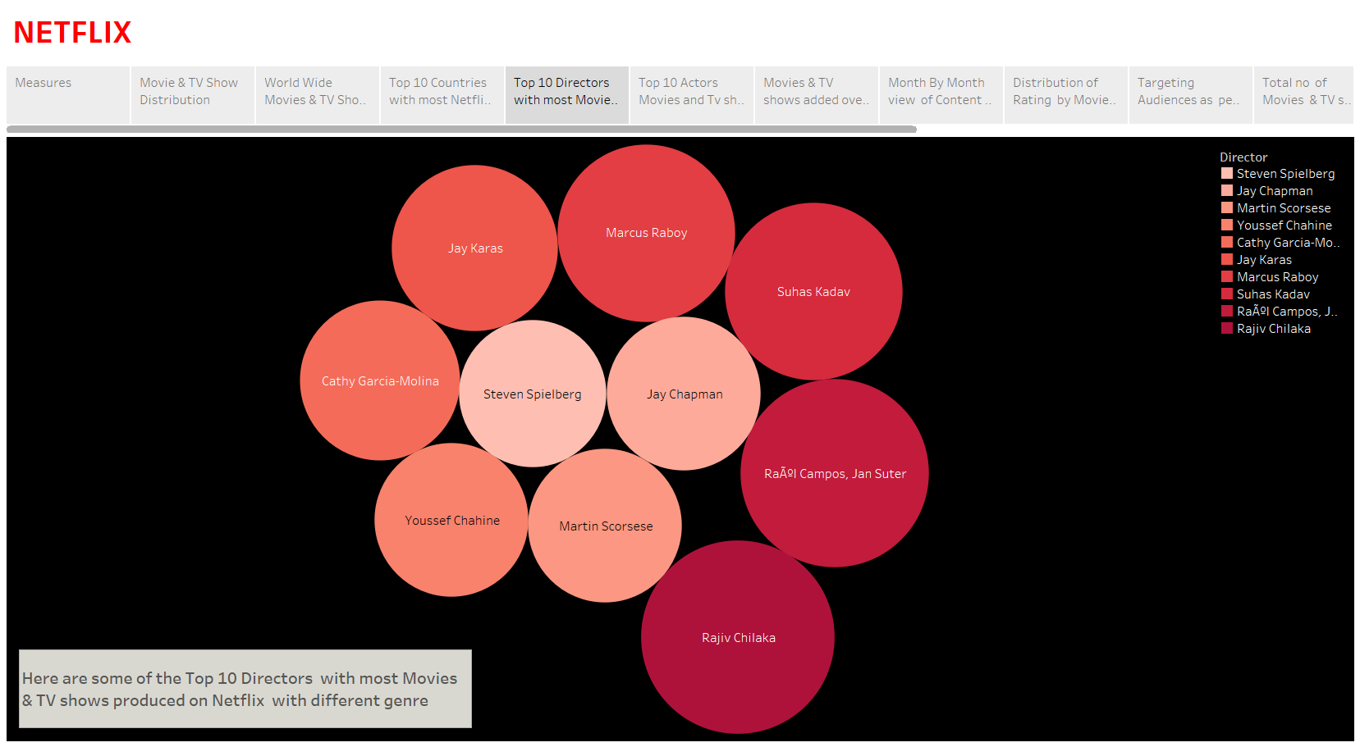

Slide 9
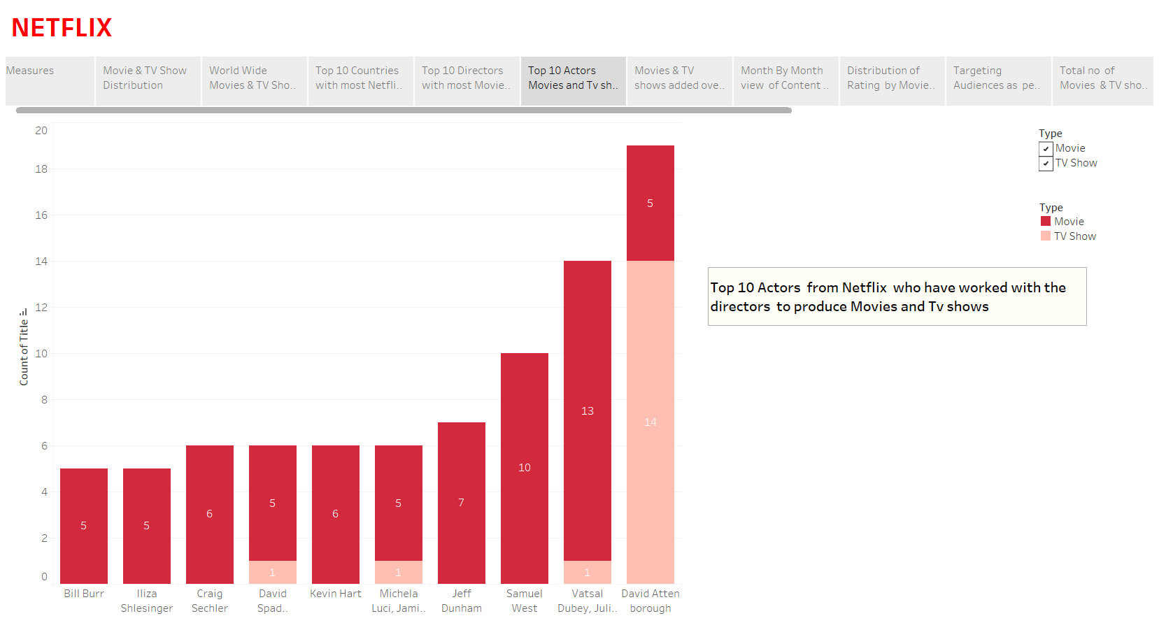

Slide 10
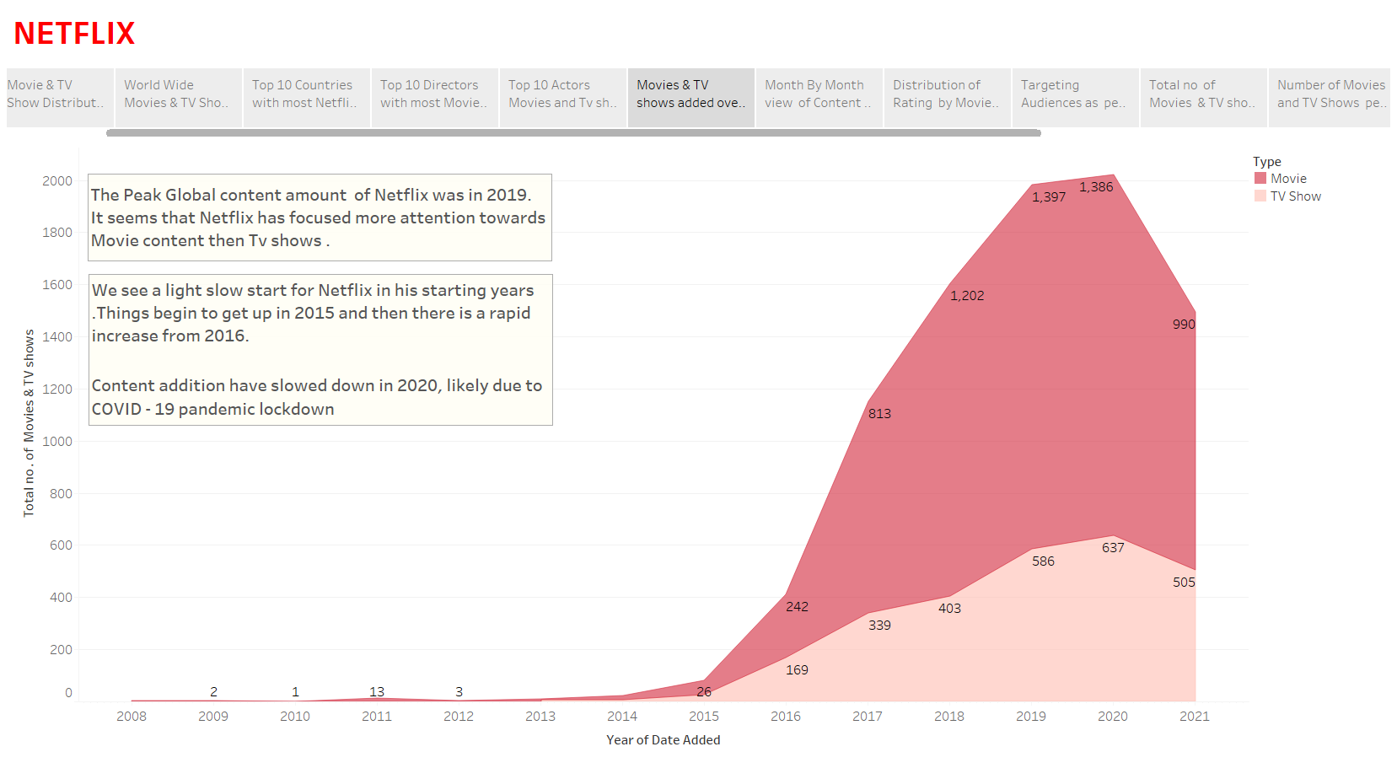

Slide 11
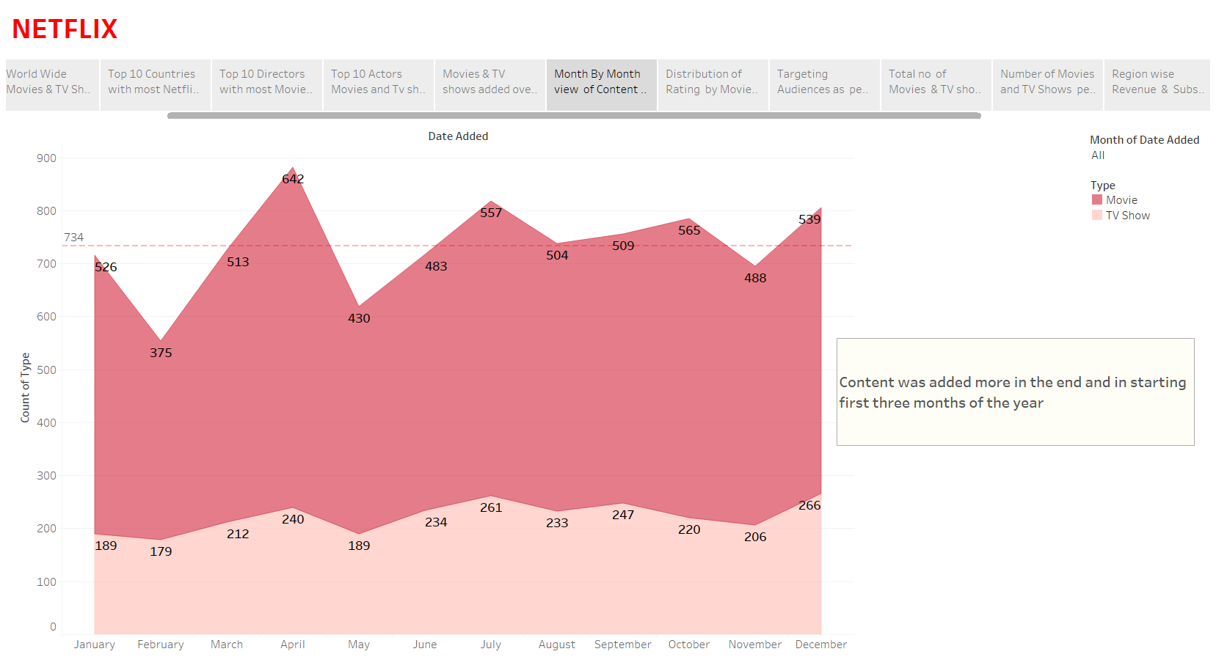

Slide 12
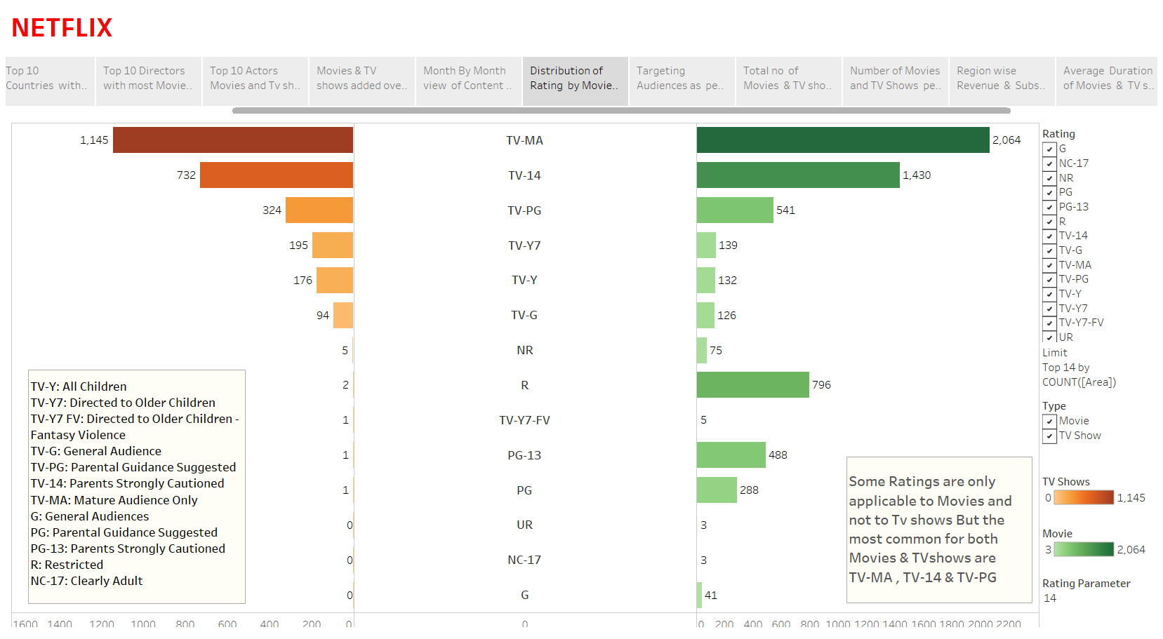

Slide 13
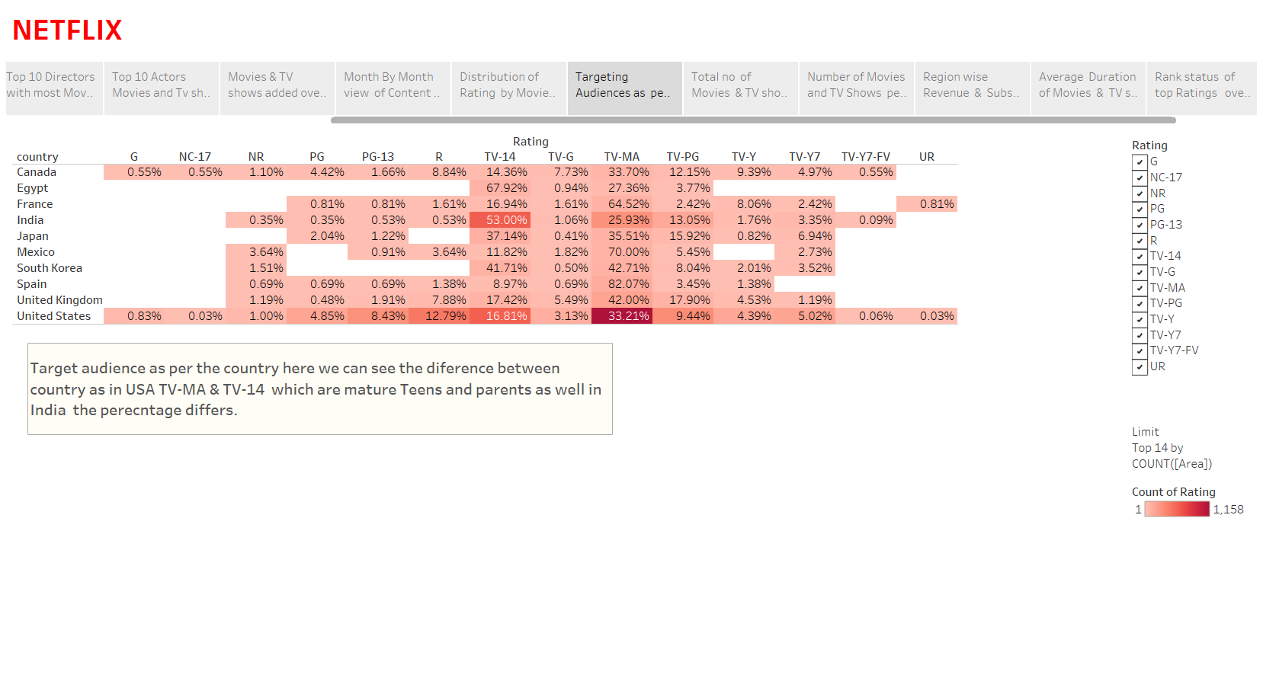

Slide 14
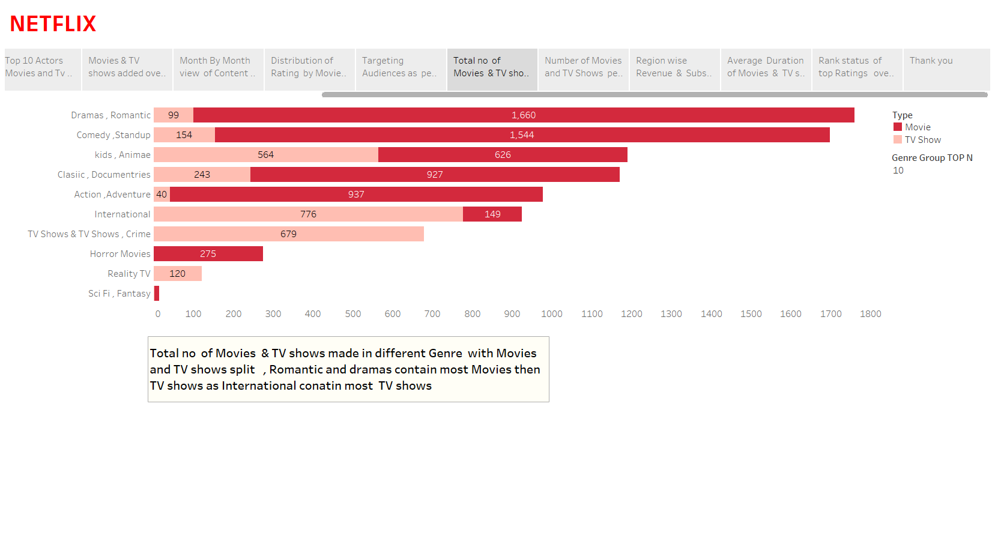

Slide 15
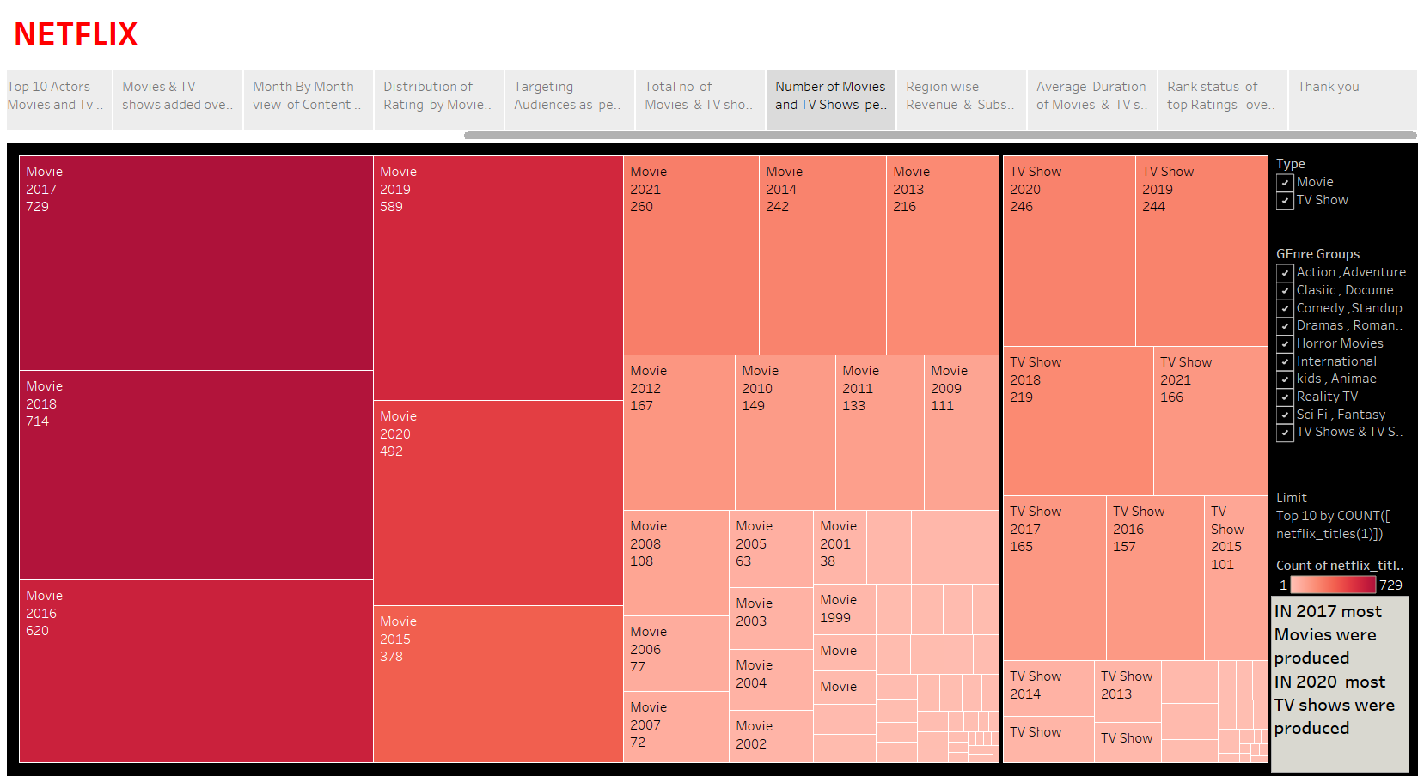

Slide 16
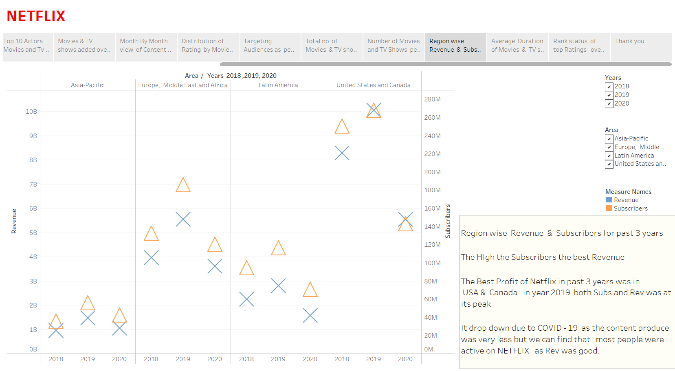

Slide 17
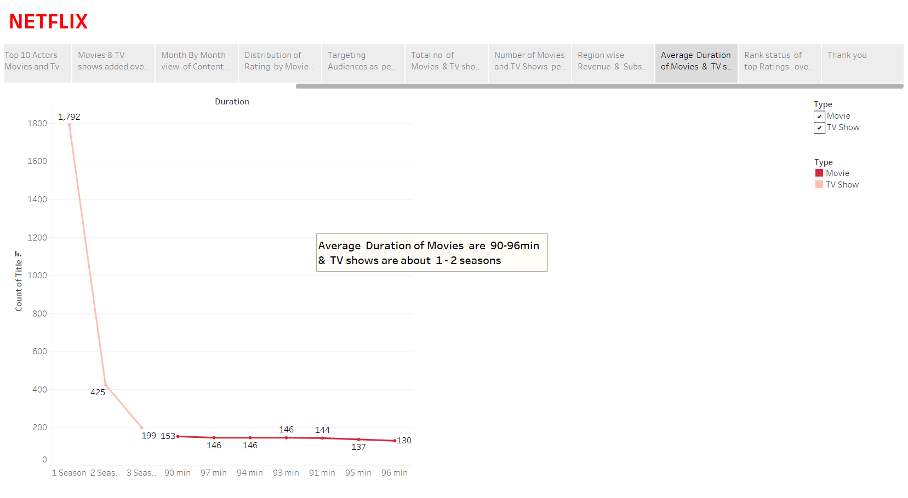

Slide 18
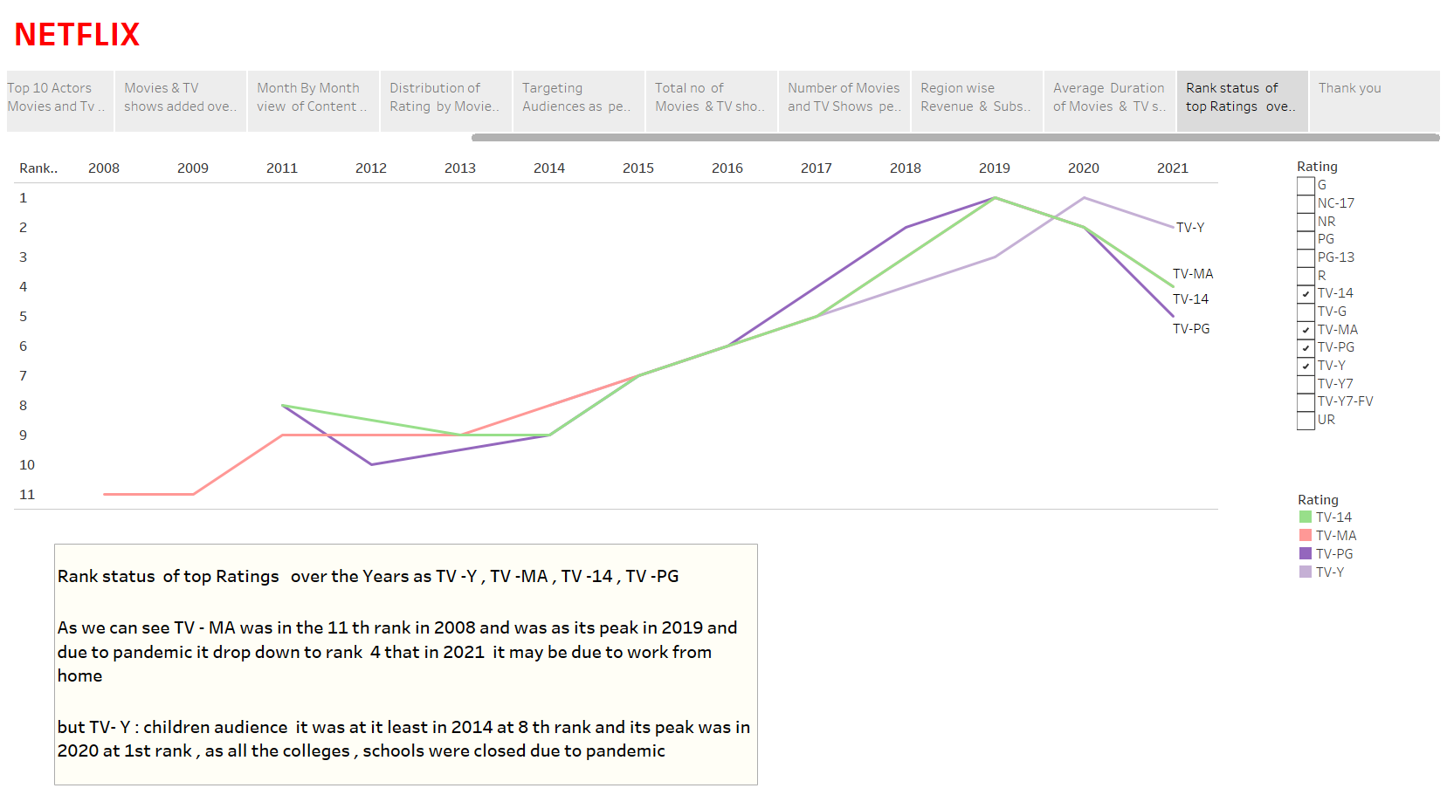

Slide 19
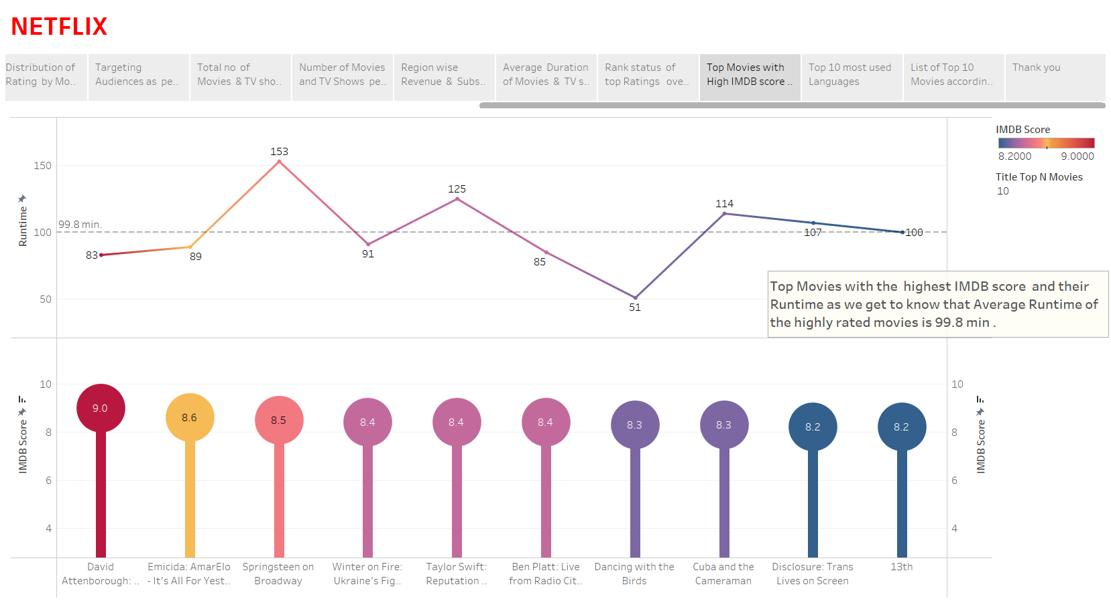

Slide 20
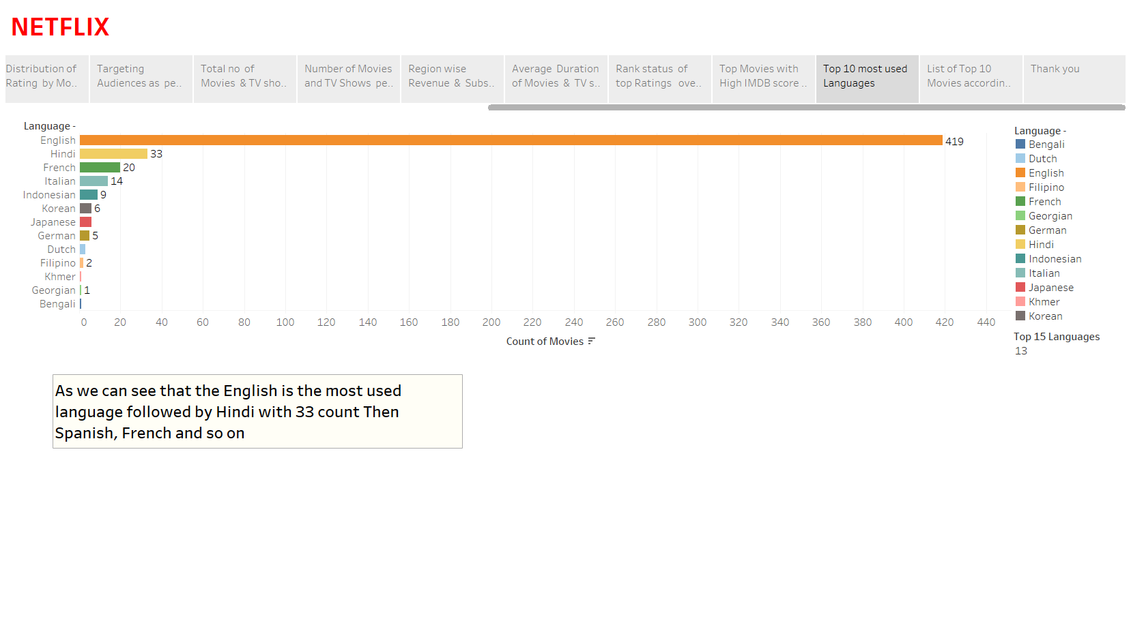

Slide 21
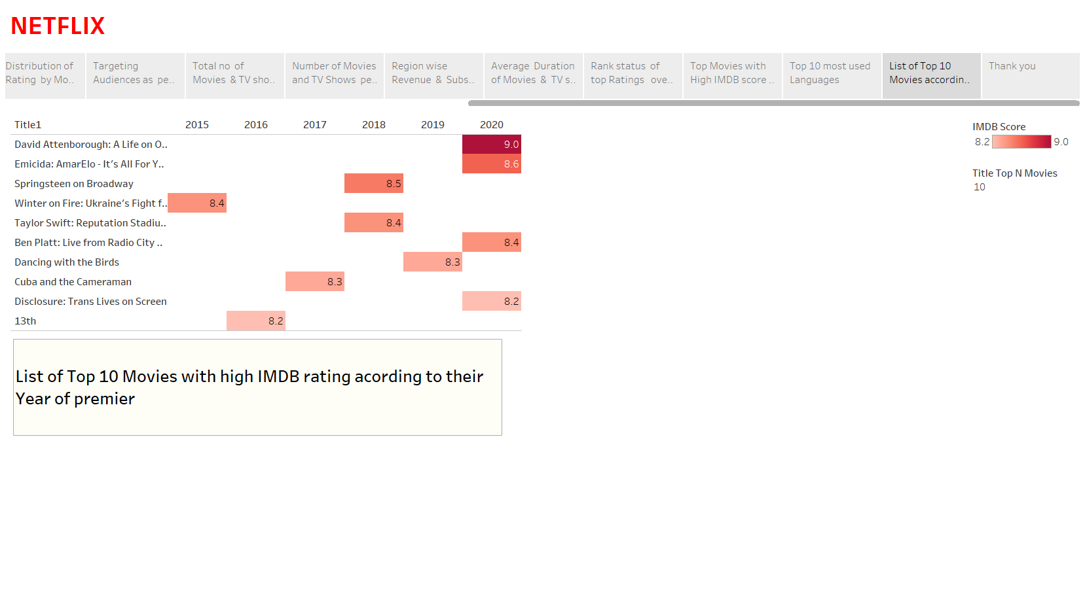

Slide 22
DYNAMIC DASHBOARD
NETFLIX

Slide 23
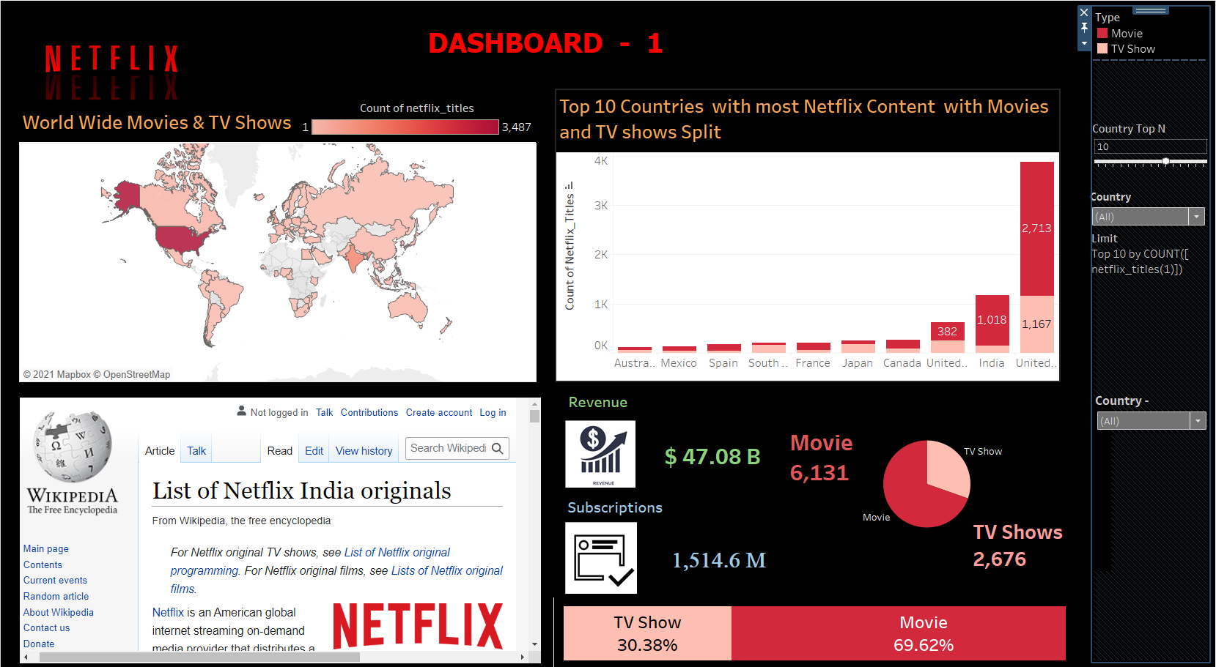

Slide 24
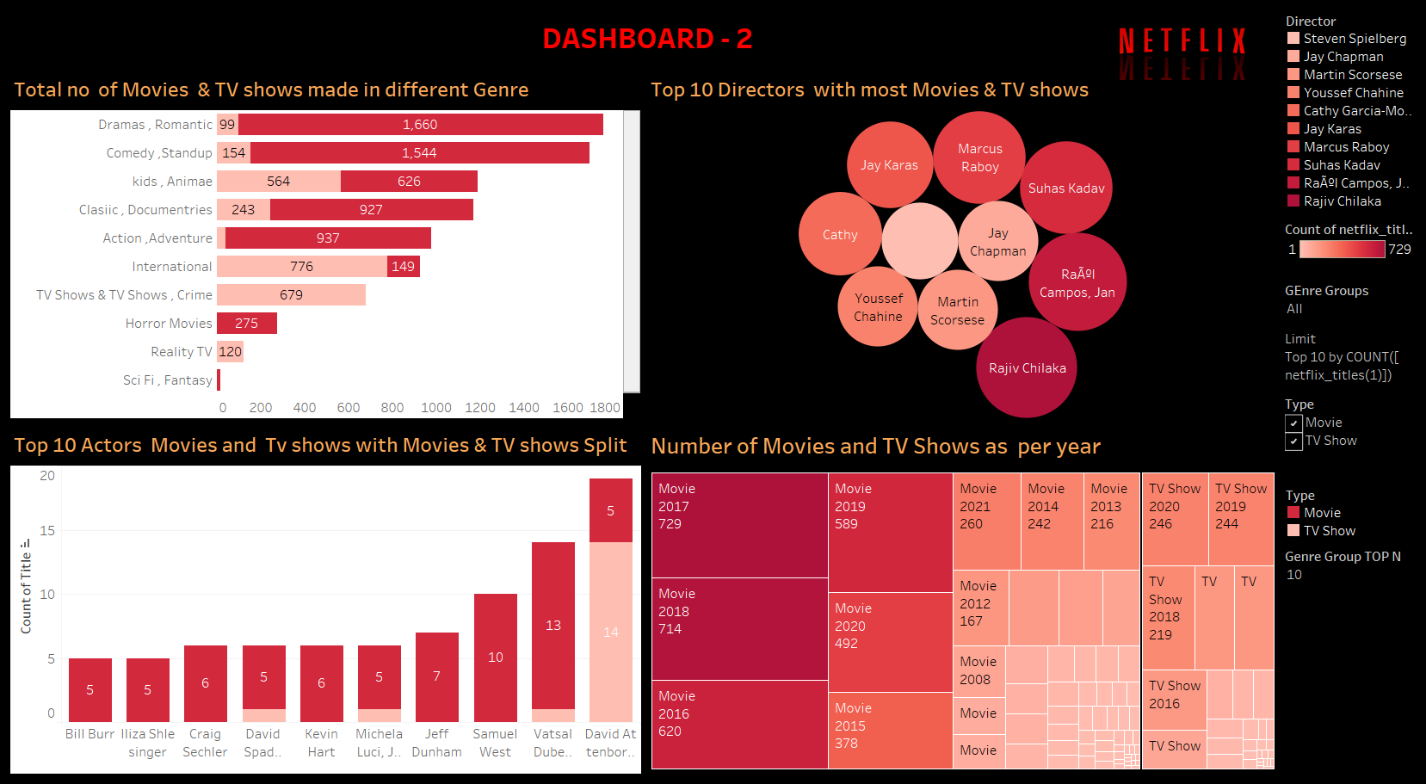

Slide 25
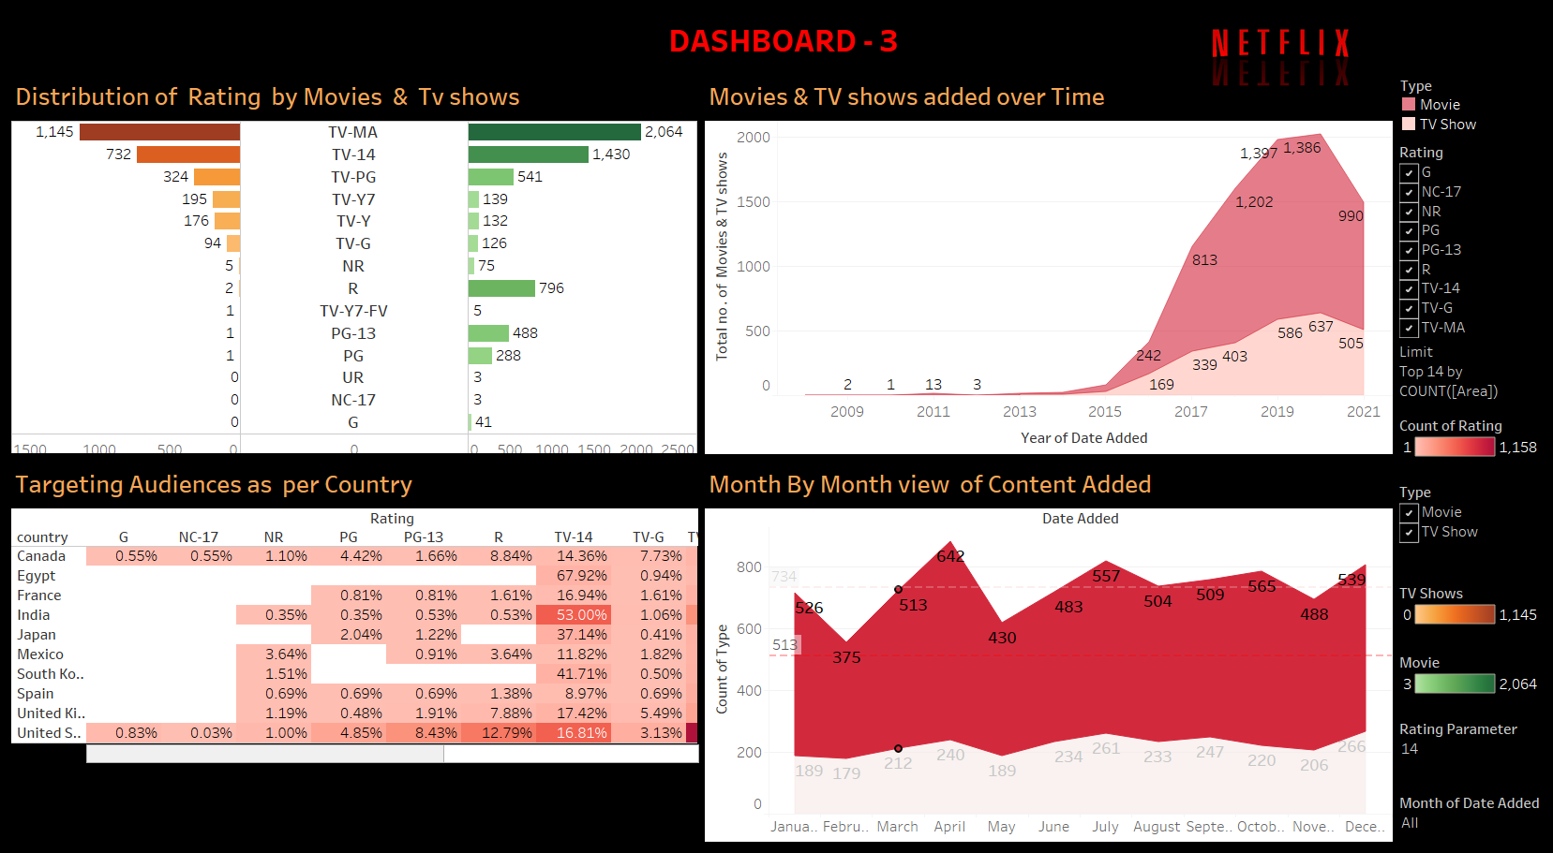

Slide 26
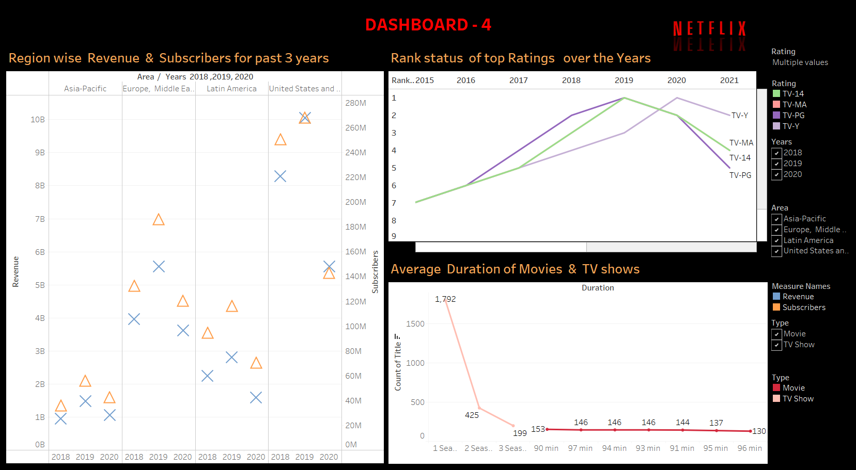

Slide 27
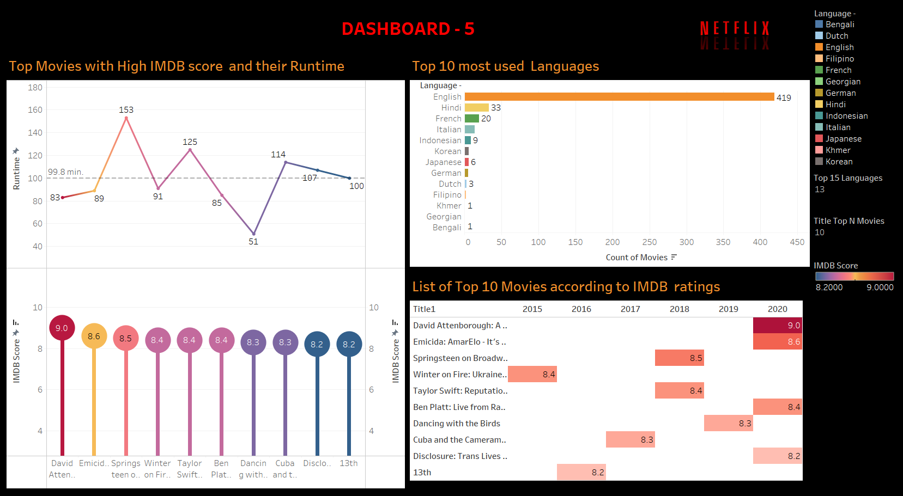

Slide 28
Conclusion
From the above analysis of Netflix dataset we were able to find out insights from the data provided
We get to know the total number of Movies , TV Shows , Total Count of Netfix Titles , Subscribers & Revenue with most contribution among countries the most language used.
Also we were able to find out top 10 movies with their IMDB ratings , also the directors and actors, with their year of premier.
Target audience to specific country & content made as per Rating .
Movies & TV shows added over the Months and Year’s .
Distribution of Subscribers and Revenues over the regions in past three years.

Slide 29
SOURCE DATA
DATASET
Netflix Movies and TV Shows https://www.kaggle.com/shivamb/netflix-shows
Netflix subscribers and revenue by country https://www.kaggle.com/pariaagharabi/netflix2020
Netflix Original Films & IMDB Scores https://www.kaggle.com/vickysen/eda-on-netflix-movies-data/
VIDEO PRESENTATION LINK
Drive video link :- https://drive.google.com/drive/folders/1LF8cODrrEVeSnQxVuSncFhRZ9ltnkTe
Youtube link :- https://youtu.be/_0TlrAZel28
Drive all files link :-
https://drive.google.com/drive/folders/1LF-8cODrrEVeSnQxVuSncFhRZ9ltnkTe

Slide 30


